Slide 1
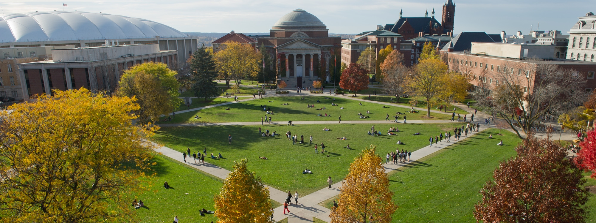
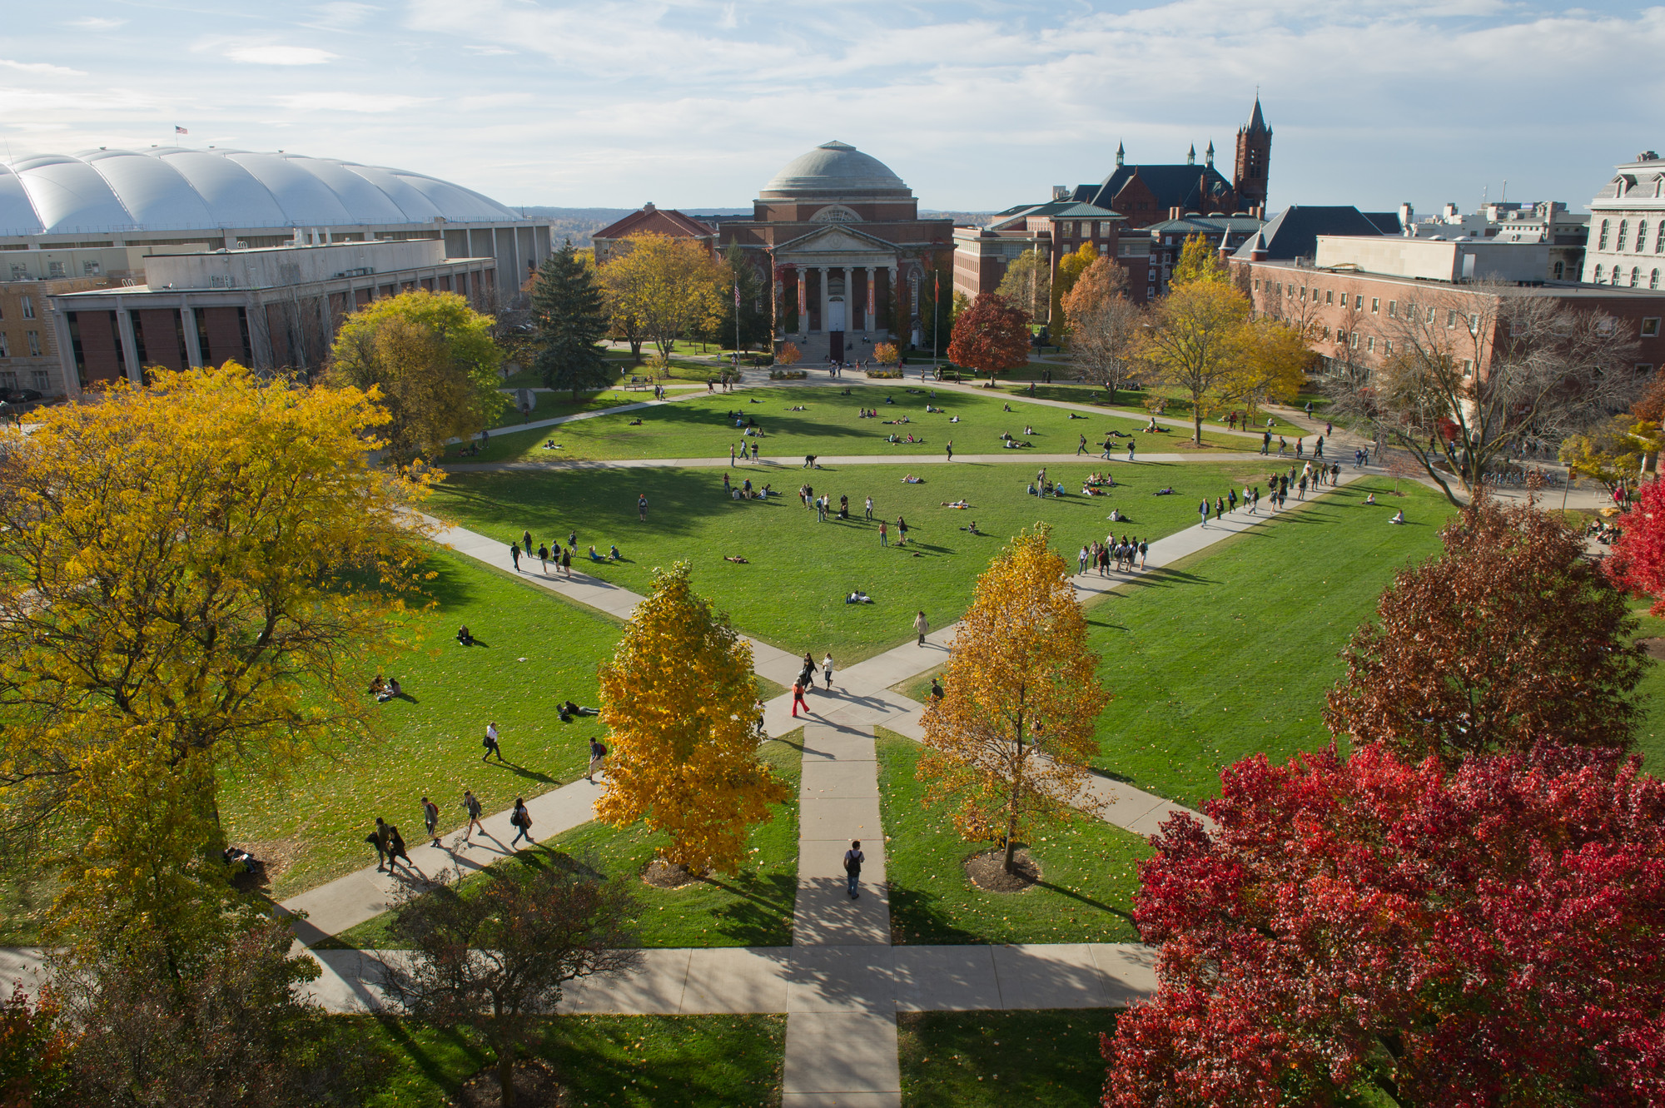
Cloud Migrations Case Study
SUNY - ITEC

Slide 2
Experiences Migrating To The Cloud
When I started in SUNY, very little (maybe 5%) of our services was cloud hosted.
Started with Gmail. We were a Google campus.
Was little interest in moving additional services off-campus due to fear-of-the-unknown, fear of loss-of-control, and lack of experience working with cloud vendors.
One ISP (although 2 egress points on campus) with marginal free bandwidth.
Part of the fear was that on-campus students would saturate campus bandwidth to/from cloud providers causing unforeseen internet outages / slowdowns and lack of application support / lack of control.
One of the other applications hosted in the cloud was the ANGEL Learning Management System. Due to difficulty with in-house support team

Slide 3
SUNY ITEC
Information Technology Exchange Center
I knew I wanted to take advantage of various hosting opportunities SUNY offered with ITEC being one of the largest.
SUNY ITEC is a private cloud hosting center located in Buffalo. Available to SUNY campuses only.
ITEC provides IaaS, PaaS, and SaaS services available for all SUNY campuses.
Provide support for most of the large-scale applications used in SUNY
BANNER ERP, Digital Measures, Degree Works, Ensemble Video, etc.
Managed Services including Oracle, MSSQL, Middleware, etc.
Made sense to begin investigating and migrating key services to ITEC

Slide 4
Infrastructure and Security Improvements
Knew I needed to make some infrastructure improvements prior to migrating services. Had quite a bit of DataCenter modernization to do!
Needed to add additional ISP’s. All of our eggs were in 1 basket
Needed to upgrade to Active Directory Environment as to support ADFS v3+
Needed to add ADFS clustering and failover features
Needed to add LDAP clustering and failover services
Needed to migrate services to virtual platform (VCenter / VSphere). Most services were still running on physical servers. Made migrating very difficult and could not be done without incurring downtime.
Could we even transplant hardware into ITEC? Don’t think so.

Slide 5
Infrastructure and Security Improvements
Retraining / Retooling staff to ‘trust’ virtualization and use the tools available and contracts in place to redeploy applications to virtual environments (both VMWare and Oracle Virtual)
Redeploy to clusters environments that nodes could be taken off-line and relocated without incurring service downtime.
Implement modern security policies including host-based firewalls, configuration management, change management, Disaster Recovery (DR), Business Continuity (BC), Disaster Avoidance (DA) programs, test plans, and response teams.
Intrusion Prevention System and Intrusion Detection System
IDS is a monitoring system. IPS is a control system
Execute a vulnerability assessment and pen test of on-campus services prior to migration
Have Data Classification Standards in place and verify provider can meet your needs (encryption, masking, etc.)

Slide 6
Acquire Data Breach Insurance
Each SUNY campus could procure Cyber Liability / Data Breach Insurance.
Helps to minimize the impact of a potential breach and provided support, funding, and proven structure to mitigate effects
If a Data Breach is to incur on a service / system hosted at a cloud vendors site, it is STILL THE RESPONSIBILITY OF THE DATA OWNER to activate the incident response team and work through the problem.
The cloud hosting vendor is not liable unless they failed to execute said security frameworks agreed to in the contract
Still, the data owner is still liable.

Slide 7
Costs Analysis On-Premise vs. ITEC
What is the cost of Private Cloud (ITEC) hosting vs. on-premise hosting?
Complete an analysis on a service-by-service instance taking into consideration direct and indirect, one-time and ongoing, fixed and variable, and opportunity and sunk costs.
Staff training and support, backups, and DR/BC/DA
Could direct training dollars at student value-added services
ITEC uses a Cost-Recovery model
Various SUNY CIO’s sit on the ITEC advisory board and provide input
Allowed for OpEx funding vs. CapEX every 5 to 7-years.

Slide 8
Costs Analysis On-Premise vs. ITEC
ITEC added value, unlike some commercial cloud providers
Do not pay income tax, 501(c)(3) not-for-profit organization
Do not need to make a profit or pay shareholder dividends
Procure hardware, software, etc. using NYS contract pricing (or better)
Are a SUNY entity and have a shared mission as their SUNY campuses.
Unlike a commercial hosting provider who may not have a SUNY shared mission
It was determined ITEC was a good value.

Slide 9
Some Concerns / Technologies to Work Through
Available IP space, Bandwidth, and Firewall Services
Host based firewalls and/or firewall appliances
IPSEC VPN back to main campus as to allow for replanting of virtual machines / services to ITEC
How many cores are available and what type of cores?
AMD vs INTEL CPU’s.
Do we need to redeploy or simply relocate?
Dedicated or shared hosts?
Hyperconverged infrastructure or classic datacenter ?
Disk Speed
Required IOPS / Shared Spindles / SSD’s / NVME’s / Server-side caching?
Available memory
How much do we have, can we increase as needed and if so, to what?
Platform (VSphere, Oracle Virtualization, etc.)

Slide 10
Some Concerns / Technologies to Work Through
How are backups done?
Additional costs of DR/BC/DA. Do we need to change backup vendors, currently VEEAM. Do we care? Are we doing to backups or ITEC?
Frequency of backups (hourly, daily, weekly, etc.) and short and long-term storage costs
Technologies supported (entire host, application level, continuous, replicated)
Distributed Administration for VSphere
VM Fault Tolerance for critical VM’s (two running concurrently, one at ITEC and one on-premise. One fails, other assumes all traffic with real-time instant failover
Performance Monitoring and how to reach remote support weekdays, weeknights, weekends, holidays?
Service Level Agreements with penalties for unscheduled service disruption
Problem Resolution

Slide 11
Initial Candidates For Migration
Initial services selected were ones where on-premise support was weak or where it was relatively easy to add a remote fail-over node.
MSSQL Server. 4 Enterprise Servers, 3 on-premise, 1 remote at ITEC. Each acting as a witness server for various services. If one fails, the witness promotes backup.
Services with few dependencies on other services. Simple web services or similar
As new services came online (and old ones were retired), we deployed at ITEC. Worked through the various issues of launching new services
Authentication (ADFS or LDAP)
Data Integration (Example: BANNER data to new service and back)
Reporting integration (Argos)
Job scheduler integration (UC4)
Backups and data replication, DR/BC/DA
Console access

Slide 12
Not All Services Could Be Hosted at ITEC
Our Content Management System was not a candidate for ITEC hosting due to it ran on DRUPAL, used MYSQL, and REDHAT LINUX
This, and similar services, were cloud hosted (AWS) with support provided by a third-party vendor.
Costs were higher but I had little choice due to lack of support options
LMS (Moodle Rooms) was another critical application that was cloud hosted (AWS) with support provided by a third-party vendor.
Both LMS and DRUPAL required ADFS (back on campus) authentication.
Illustrated a need for a distributed authentication system, like Office365 on Azure replicating to/from our on-campus AD environment for pure 100% cloud access

Slide 13
Lessons Learned or Key Metrics to Be Aware Of
Don’t believe everything you hear, read, or are promised. Get it in writing!
Don’t be in a hurry to jump to the cloud. Do the analysis.
Don’t get talked into “you need a higher tier of service” by vendors or your staff!!! Run, measure, then determine if you need more cloud hardware.
Make sure you have a backout plan or an exit strategy for each migrated system or service!
Don’t trade (good security + on-premise hosting) for (cloud hosting + weaker security).
Security is the #1 thing that keep smart CIO’s awake at night!
Don’t think cloud = less expensive. Depends on numerous attributes.
Some services may be less expensive to run in the cloud, some surely are not!
It depends on the not-for-profit status and need to make a profit of your cloud provider.

Slide 14
Lessons Learned or Key Metrics to Be Aware Of
A 99.9% guaranteed uptime metric IS NOT GOOD! There are 525,600 minutes in a year. 99.9% uptime means (.001x 525,600) = 525.6 minutes of UNSCHEDULED downtime per year. 8.76 hours!
Ask for 99.99% uptime guarantee and have financial penalties in your contract if not met
Denial-of-Service attacked targeting a specific campus at your cloud hosting site can cause a disruption for the entire cloud vendor and all tenants contained within
Make sure there’s a good DOS mitigation plan!
Review all potential hosting environment (on-premise, cloud, private cloud, etc.) and choose the best based on the business need. Remember IT serves the business regardless of what the business is! IT for the sake of IT is useless!

Slide 15

Questions

